Slide 1


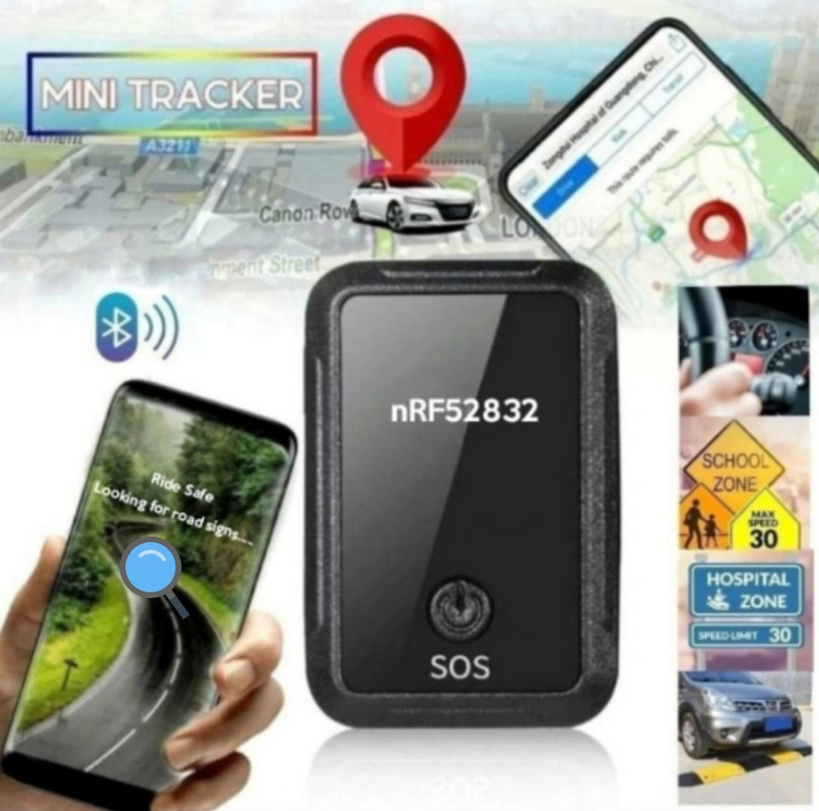

Success Champions
TRACKING ASSISTANCE USING NORDIC NRF52832 BLUETOOTH MODULE
“Alert today-Alive tomorrow”
UNIQUE ID: IC2023-332
TEAM MEMBERS: C.Elakshme Devi | Seru Mounika | R.Bhaanushri

Slide 2

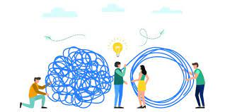

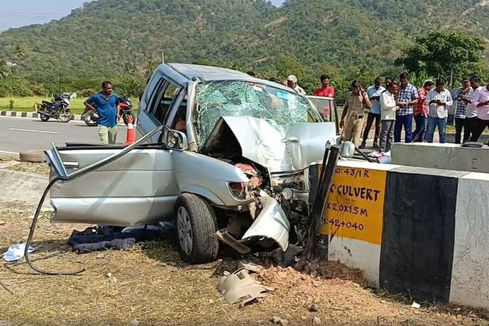

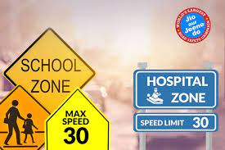
Source:https://timesofindia.indiatimes.com/india/record-1-68-lakh-road-accident-deaths-in-2022-1-every-3-minute/articleshow/104384010.cms?from=mdr
PROBLEM
VEHICLE COLLISION
LACKING ROAD SIGNS AWARENESS
NO SAFETY IN PEDESTRIAN PRIORITY AREAS
Problem 1
Problem 2
Problem 3
People are prone to accidents due to not following road signs and being unaware of it.
Some drivers may not be aware of or choose to disregard the specific hours during which school zone rules are in effect.
Majority of accidents are occurred during night times and this is because of the lack of seeing and not following the road signs.
India recorded the highest number of road crash fatalities,462 deaths per day or one every three minutes.

Slide 3
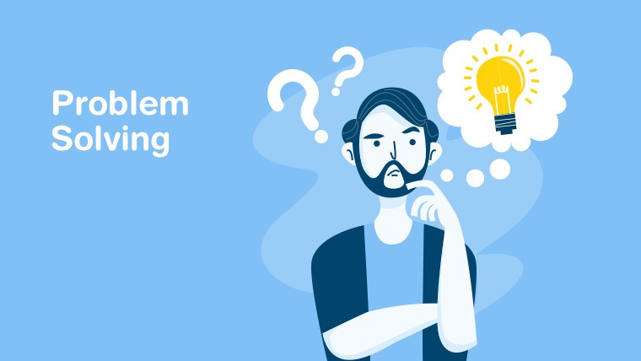

SOLUTION
Saving lives using bluetooth module
Real time tracking
Voice Notification prior to 100m
Compatible model with user friendly receiver end

Slide 4



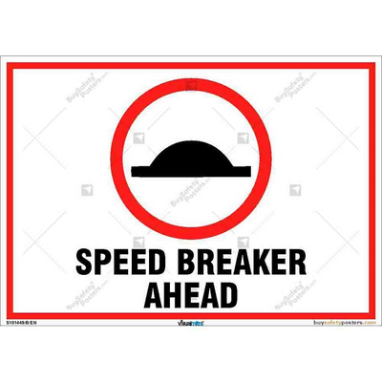
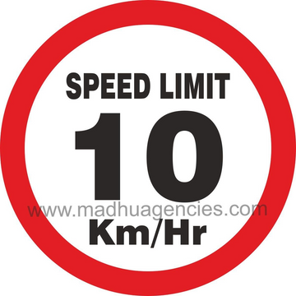

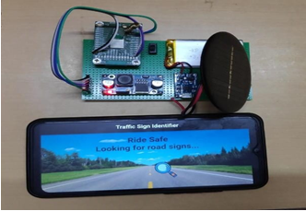

WHAT WE CATER........
Our project works on the principle of RF communication technology under 2.4GHz using the Bluetooth technology where we have used the high range Bluetooth module and it should be constantly powered under 3.3V which is done using the renewable source of energy.
WHAT OUR PRODUCT CAN DO...........
Save lives of people by giving voice notification.
Tells us about obstacles and road signs prior to 100m.
Makes people aware of road signs.
User friendly application that can be used to be aware of road signs.

Slide 5

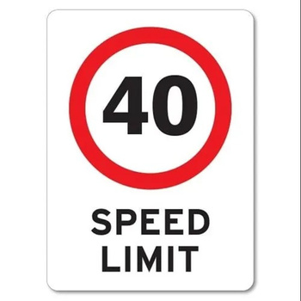
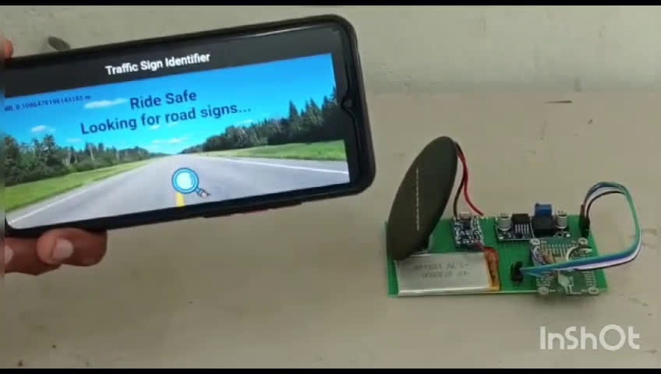
PROOF OF CONCEPT (DEMO VIDEO)

Slide 6



Voice Notification
Conditional response
mechanism
UNIQUENESS
Our product from others
Works in any climate
No limitation of devices
Accurate detection

Slide 7



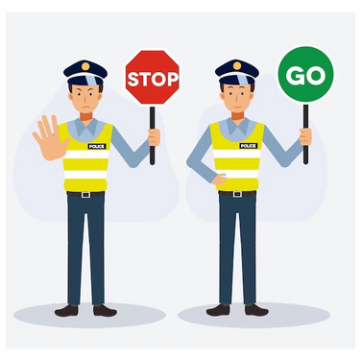



WHOM WE CATER ...............
Drivers
Tourists
Traffic Police
Ministry of Road Transport and Highways

Slide 8
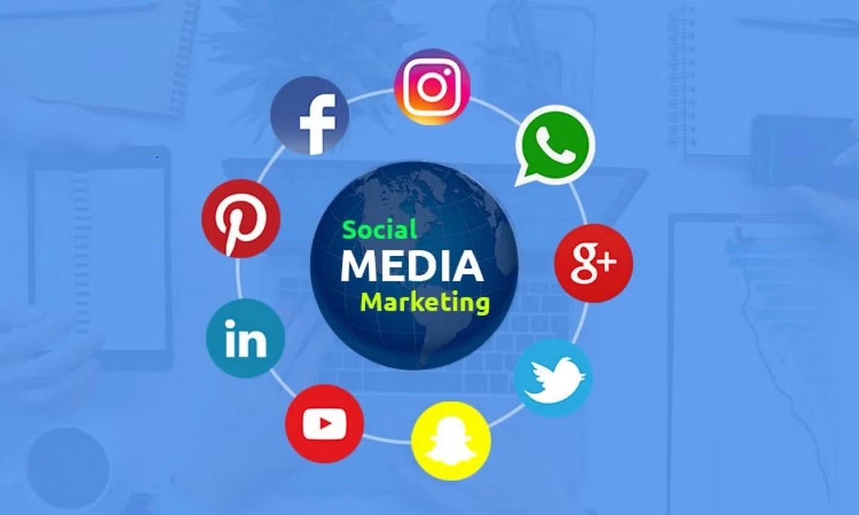

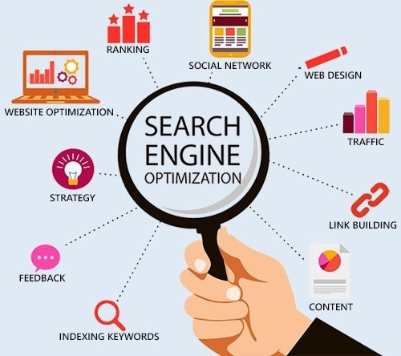


HOW WE CATER..........
Social Media Marketing(SMM)
Word Of Mouth(WOM)
Search Engine Optimization(SEO)

Slide 9






TIMELINE FROM IDEA TO A PRODUCT(2023-2024)
OCT 2023
Designing functional prototype
FEB 2024
Testing of prototype in real world conditions
1
2
3
4
5
AUG 2023
Idea and concept generation
DEC 2023
Developing real time prototype
APRIL 2024
Client approval and production

Slide 10






INVESTMENT COST
 | HARDWARE COMPONENT | Bluetooth module Lithium ion battery Solar panel | 3,500/-
 | SOFTWARE | User friendly application using flutter framework | 5,000/-
 | BODY BUILDING | Outer material Miscellaneous | 1,500/-
 | FINAL TESTING AND MARKETING | Testing Marketing | 5,000/-
 | TOTAL AMOUNT REQUIRED | Amount required for full product in total | 15,000/-

